Slide 1
Pick Up
Drop Off
Yellow-Taxi Analysis in NYC
Presented by Bilibili Group
Dongqi Fu, Qingfeng Han, Sudan Zhang
Notes:
The past year has been a PR nightmare for Uber, as the ride-sharing company has committed all sorts of blunders — legal and otherwise. Uber has been accused of sexual harassment, stealing trade secrets and profiteering off protests.

Slide 2
CONTENTS
Solution
Background
Technical
Details
Teamwork

Slide 3
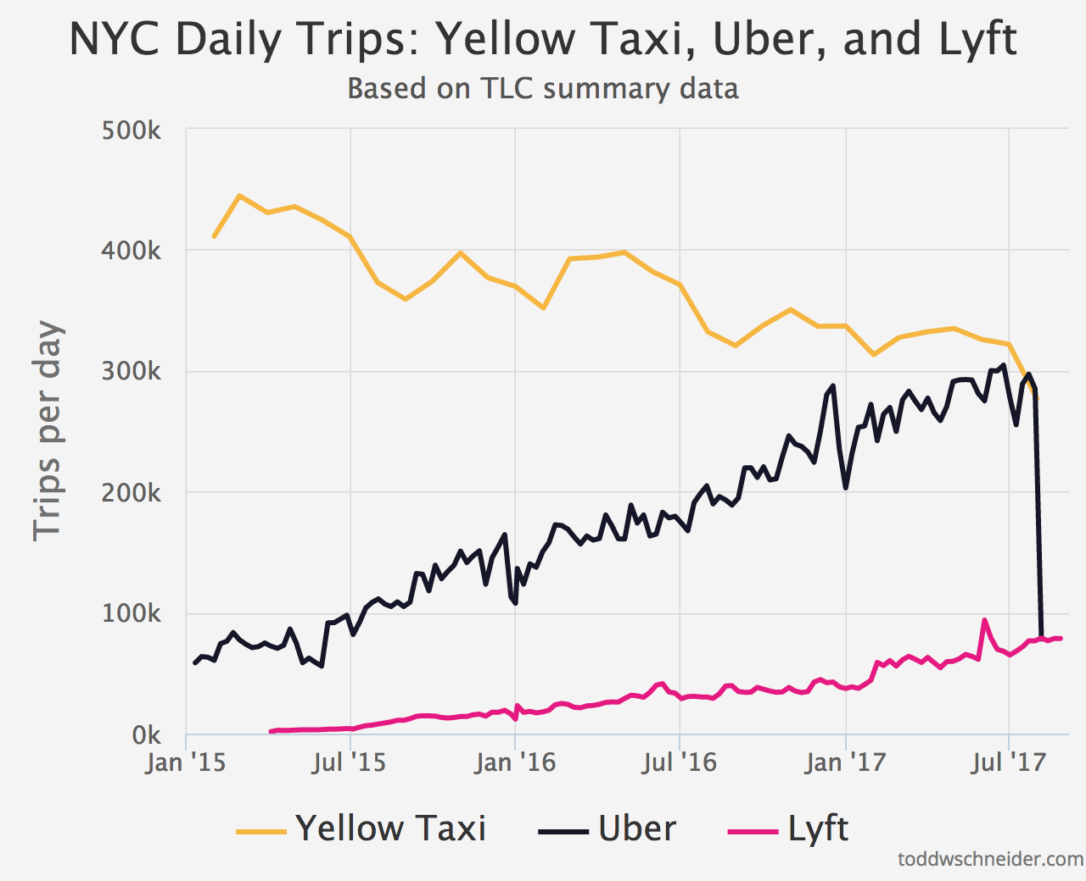
Background - Why we choose this topic
Volume
1.1 billion individual taxi trip
from Jan. 2009 to Jun. 2015
Veracity
LA(single) vs. NYC(multiple)
Notes:
According to The New York City Taxi & Limousine Commission, there are 1.1 billion individual taxi trips in the city from January 2009 through June 2015
The official TLC trip record dataset contains data for over 1.1 billion taxi trips from January 2009 through June 2015, covering both yellow and green taxis.

Slide 4
Background - Why interesting? How Useful? Why important?
How bad is the rush hour traffic from Midtown to JFK Airport?
Where does the Bridge and Tunnel crowd hang out on Saturday nights?
Our visuals address all of these questions and many more.
Interesting
What time do investment bankers get to work?
Useful
How has Uber changed the landscape for taxis?
Important
Could Bruce Willis and Samuel L. Jackson have made it from 72nd and Broadway to Wall Street in less than 30 minutes?

Slide 5
Solution – Who is the audience?
Ride-sharing service
Individuals
(especially for tourists)

Slide 6
Solution – Story Telling
What if ofo wants to enter into NYC after landed in Seattle?
How can Uber and Lyft extend market share?
Notes:
One day ….

Slide 7
Solution – What are the deliverables?

Slide 8
Technical Details – What are the design considerations?

Slide 9
Technical Details – How to design, build and evaluate?

Slide 10
Technical Details – Comparison?

Slide 11
Technical Details – What’s cool?

Slide 12
Technical Details – What’s technology going to use?

Slide 13
Technical Details – How to use interactive visuals?

Slide 14
Teamwork – How to work together?

Slide 15
Teamwork – Timeline?

